Slide 1

The NIST PQC Project
Dustin Moody
Post-Quantum Cryptography Team

Slide 2
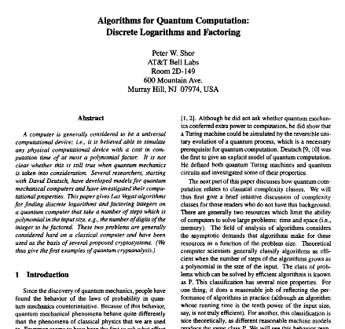
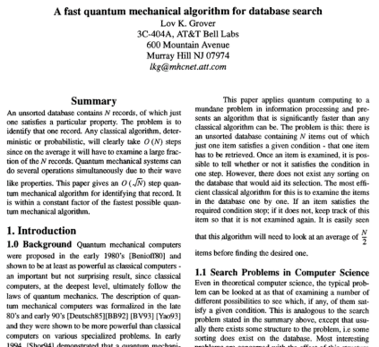
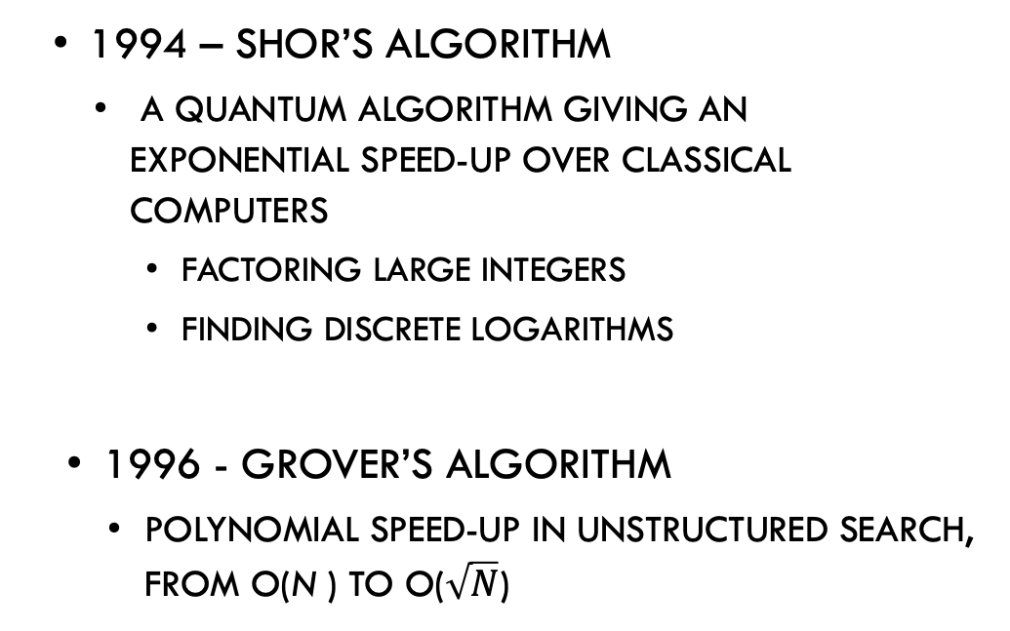
Motivation
1994 – Shor’s algorithm
  a quantum algorithm giving an exponential speed-up over classical computers
    Factoring large integers
    Finding discrete logarithms
1996 - Grover’s algorithm
  polynomial speed-up in unstructured search, from O(N ) to O($\sqrt{N}$)

Slide 3
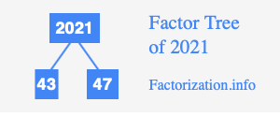
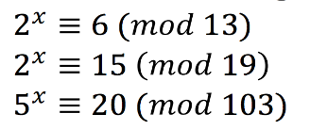
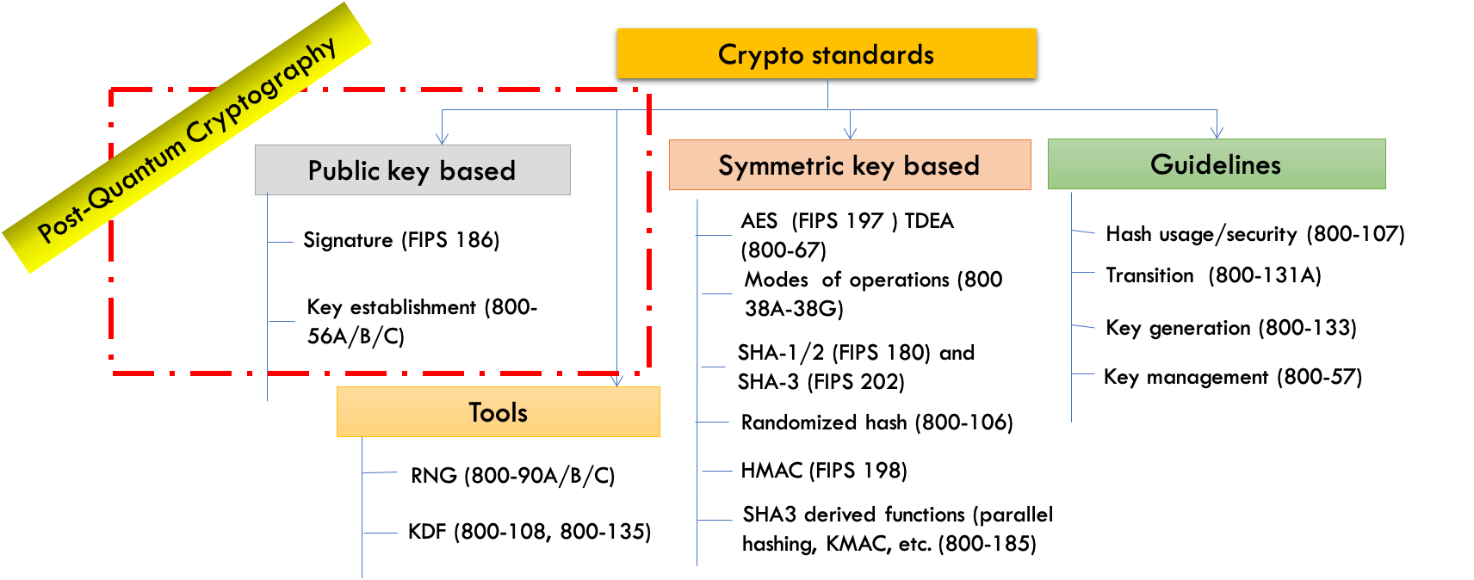
The Quantum Threat
NIST public-key crypto standards
  SP 800-56A: Diffie-Hellman, ECDH
  SP 800-56B: RSA encryption
  FIPS 186: RSA, DSA, and ECDSA signatures
all vulnerable to attacks
from a (large-scale)
quantum computer
Symmetric-key crypto (AES, SHA) would also be affected, but less dramatically
Notes:
In the 1990s, this wasn’t yet a practical threat. No real quantum computers

Slide 4

How soon do we need to worry?

Slide 5
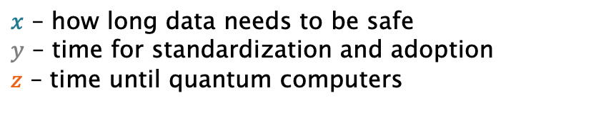
How soon do we need to worry?
Theorem (Mosca): If x + y > z, then problem
What do we do here??
y
x
z
secret keys revealed
time
$x$ – how long data needs to be safe
$y$ – time for standardization and adoption
$z$ – time until quantum computers
Notes:
Reasons:
Standardization and adoption is slow – think about all that has to happen to be protected.
Harvest now, decrypt later threat exists now

Slide 6
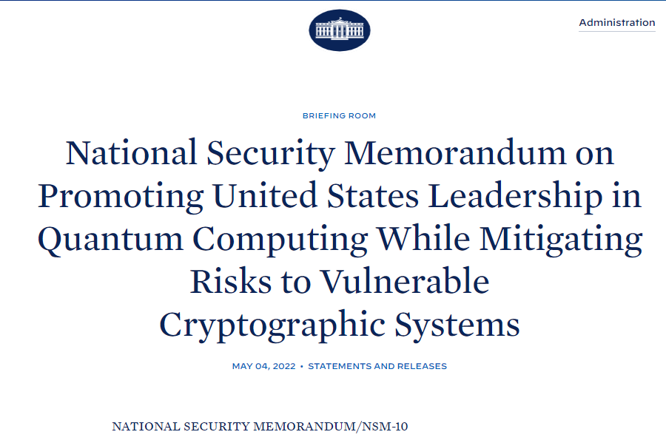
White House National security memo
“Within 1 year of the release of the first set of NIST standards for quantum-resistant cryptography …, the Director of OMB … shall issue a policy memorandum requiring FCEB Agencies to develop a plan to upgrade their non-NSS IT systems to quantum-resistant cryptography.”

Slide 7
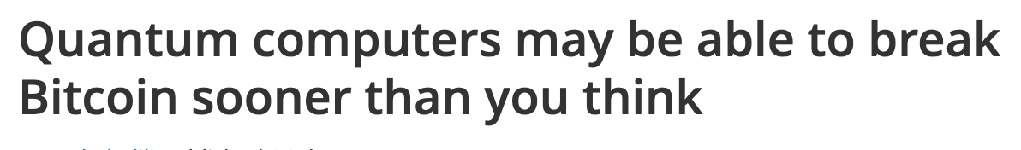
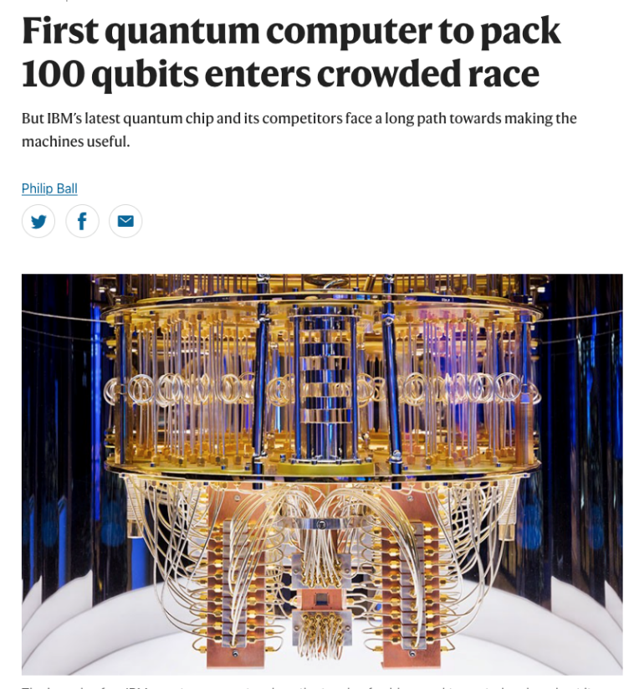
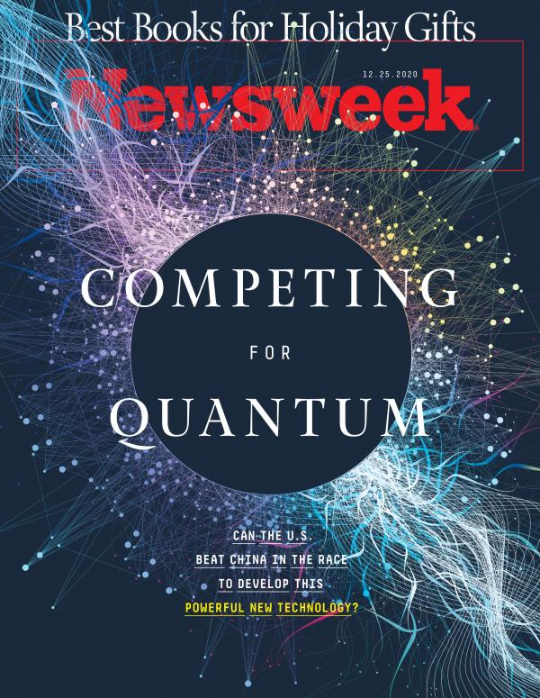
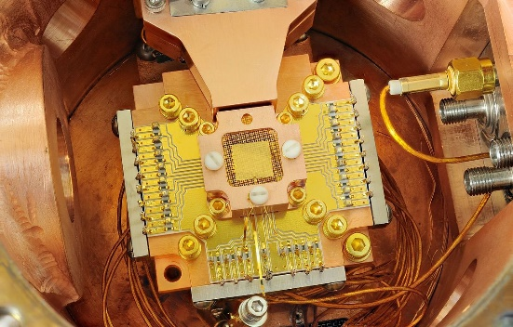
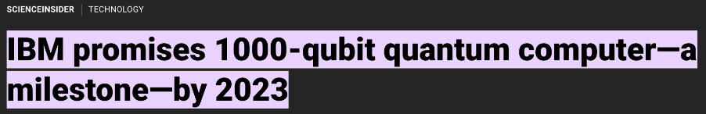
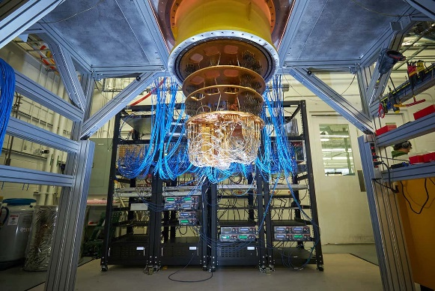
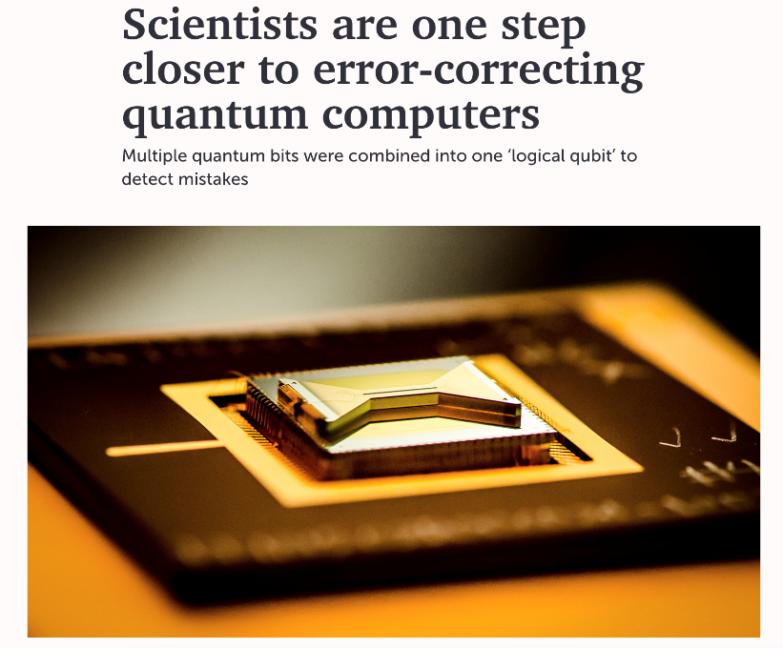
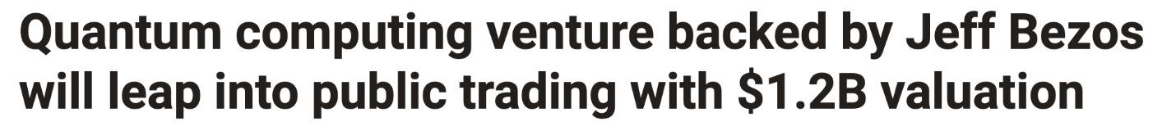
Progress of Quantum Computing
Notes:
Some experts predict 10-15 years. Nobody knows for sure

Slide 8
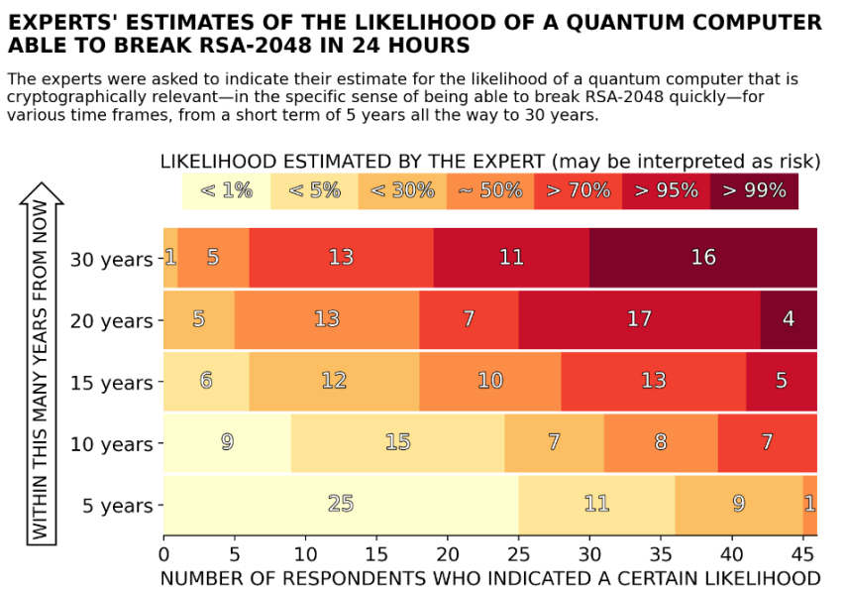
When will a Quantum Computer be Built?
Source: M. Mosca, M. Piani, Quantum Threat Timeline Report, 2021 https://globalriskinstitute.org/publications/2021-quantum-threat-timeline-report//
Notes:
(Jan 2022) – just a little bit more likely, but also one year later w/o a quantum computer.
46

Slide 9
Quantum Cryptography aka QKD
Using quantum technology to build cryptosystems
  Theoretically unconditional security guaranteed by the laws of physics
Limitations
  Can do encryption, but not authentication
  Quantum networks not very scalable
  Expensive and needs special hardware
Lots of money being spent on “quantum”
This is NOT our focus

Slide 10






NIST PQC Milestones and Timelines
2010-2015
NIST PQC project team builds
First PQC conference
2016
Determined criteria and requirements, published NISTIR 8105
Announced call for proposals
2017
Received 82 submissions
Announced 69 1st round candidates
2018
Held the 1st NIST PQC standardization Conference
2019
Announced 26 2nd round candidates, NISTIR 8240
Held the 2nd NIST PQC Standardization Conference
2020
Announced 3rd round 7 finalists and 8 alternate candidates. NISTIR 8309
2021
Hold the 3rd NIST PQC Standardization Conference
2022 Make 3rd round selection and draft standards
2023 Release draft standards and call for public comments

Slide 11
Call for Proposals
NIST called for quantum-resistant cryptographic algorithms for new public-key crypto standards
  Digital signatures
  Encryption/key-establishment
Our role: managing a process of achieving community consensus in a transparent and timely manner
Different and more complicated than past AES/SHA-3 competitions
We will not pick a single “winner”
  Ideally, several algorithms will emerge as ‘good choices’

Slide 12
Selection criteria
Secure against both classical and quantum attacks
Performance - measured on various "classical" platforms
Other properties
  Drop-in replacements - Compatibility with existing protocols and networks
  Perfect forward secrecy
  Resistance to side-channel attacks
  Simplicity and flexibility
  Misuse resistance, and
  More

Slide 13
Security categories
Security – against both classical and quantum attacks
Computational resources should be measured using a variety of metrics
  Number of classical elementary operations, quantum circuit size, etc…
  Consider realistic limitations on circuit depth (e.g. 2⁴⁰ to 2⁸⁰ logical gates)
  May also consider expected relative cost of quantum and classical gates.
Level | Security Description
I | At least as hard to break as AES128 (exhaustive key search)
II | At least as hard to break as SHA256 (collision search)
III | At least as hard to break as AES192 (exhaustive key search)
IV | At least as hard to break as SHA384 (collision search)
V | At least as hard to break as AES256 (exhaustive key search)
Notes:
the NIST security strength categories are defined in a way that leaves open the relative cost of various computational resources, including quantum gates, classical gates, quantum memory, classical memory, hardware, energy, time, etc.
The idea is that in order to meet, for example, category 1, the best attack violating the security definition of a parameter set should cost more than a brute-force key search attack on a single instance of AES-128, according to any plausible assumption regarding the relative cost of the various computational resources involved in a real-world attack.
Different opinions can arise regarding what constitutes a plausible assumption regarding the relative cost of computational resources.
even if one has agreed upon a model, or a range of models, for evaluating the relative cost of various computational resources, there may still be uncertainty how much of a given resource an attack actually requires.

Slide 14

The 1st and 2nd Rounds
Round 1 (Dec ‘17 – Jan ‘18)
  69 candidates and 278 distinct submitters
  Submitters from >25 countries, all 6 continents
  Apr 2018, 1st NIST PQC conference
  Almost 25 schemes broken/attacked
  NISTIR 8240, NIST Report on the 1st Round
Round 2 (Jan ‘18 – Jul ‘20)
  26 candidates
  Aug 2019 – 2nd NIST PQC conference
  Schemes broken/attacked: LAC, LedaCrypt, Round5, Rollo, RQC, LUOV, MQDSS, qTESLA
  NISTIR 8309, NIST Report on 2nd Round
Both rounds: research, cryptanalysis, pqc-forum, official comments, benchmarking, mergers
 | Signatures | KEM/Encryption | Overall
Lattice-based | 5 | 21 | 26
Code-based | 2 | 17 | 19
Multi-variate | 7 | 2 | 9
Symmetric based | 3 |  | 3
Other | 2 | 5 | 7
Total | 19 | 45 | 64
 | Signatures | KEMs/Encryption | Total
Lattice-based | 3 | 9 | 12
Code-based | 0 | 7 | 7
Multi-variate | 4 | 0 | 4
Symmetric-based | 2 |  | 2
Other | 0 | 1 | 1
Total | 9 | 17 | 26
Notes:
A world-wide effort
Pqc-forum has been helpful, but a challenge

Slide 15
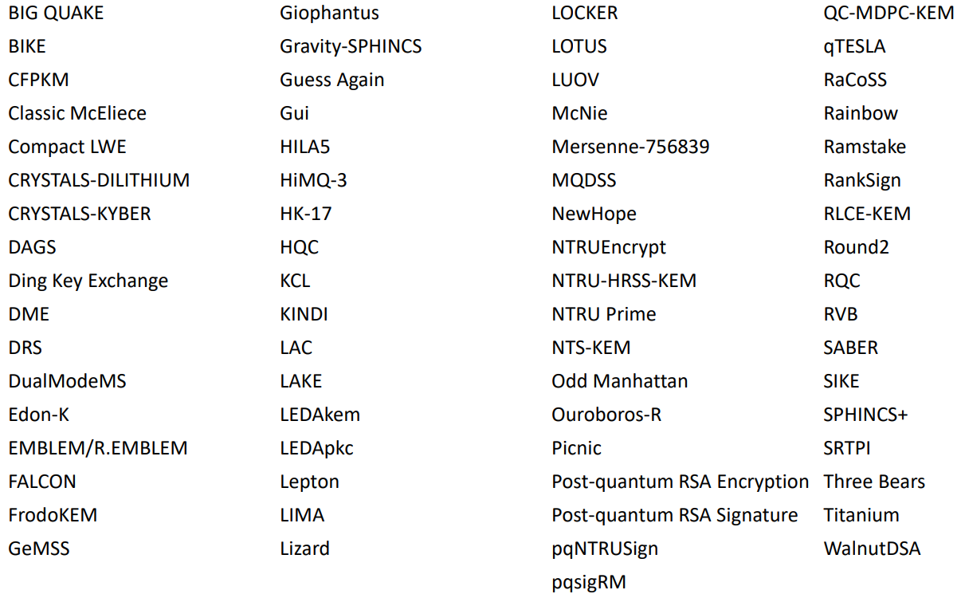
The candidates (1st round)

Slide 16
The 3rd Round Finalists and Alternates
NIST selected 7 Finalists and 8 Alternates
  Finalists: most promising algorithms we expect to be ready for standardization at end of 3rd round
  Alternates: candidates for potential standardization, most likely after another (4th) round
 | FINALISTS | ALTERNATES
KEMs/Encryption | Kyber NTRU SABER Classic McEliece | BIKE FrodoKEM HQC NTRU Prime SIKE
Signatures | Dilithium Falcon Rainbow | GeMSS Picnic SPHINCS+
Notes:
Talk about narrowing it down. Some attacked.
Merger, lattice KEMS.
Two buckets
Had to eliminate some good schemes (New hope, 3 bears)
Explained in our report about all 26 (unlike 1st report).

Slide 17
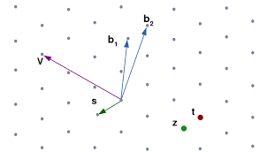
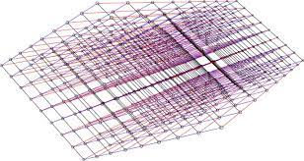
The Lattice KEMs
The finalists Kyber, NTRU, SABER are based on structured lattices
  Kyber and SABER are based on module-LWE/LWR
  NTRU is based on the NTRU problem
  All three have good performance (in terms of efficiency and key/ciphertext sizes)
  NIST expects to select at most one for standardization
The alternates NTRU Prime and FrodoKEM are based on lattices
  NTRUprime uses structured lattices, while FrodoKEM does not

Slide 18
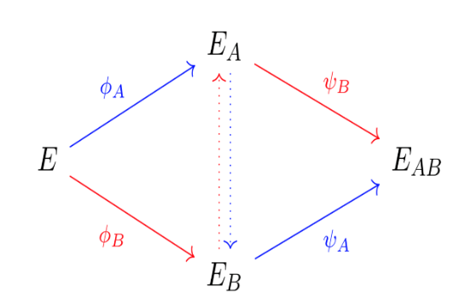
The Other KEMs
Classic McEliece, the other finalist, is code-based
  Been around since 1978
  Very large public keys, but very small ciphertexts
The alternates BIKE and HQC are based on structured codes
  Both have much smaller key sizes than Classic McEliece
The final alternate SIKE is based on isogenies of elliptic curves
  Small key/ciphertext sizes, slower than other candidates
(001)
(011)
(101)
(111)
(000)
(010)
(100)
(110)

Slide 19

The Signatures
The finalists Dilithium and Falcon are both based on structured lattices
  Dilithium is Fiat-Shamir style, while Falcon is hash then sign
  Both have good performance
The alternate Picnic is based on zero-knowledge proofs and a block cipher
The alternate SPHINCS+ is based on the security of hash functions
  The security of SPHINCS+ is very well understood
  SPHINCS+ is stateless
There are two multivariate schemes: the finalist Rainbow, and the alternate GeMSS
  Both have large public keys, and very small signature sizes

Slide 20
The state of the signatures
Cryptanalytic results during the 3rd round have created some concerns about the security of both multivariate schemes Rainbow and GeMSS
Beullens recently posted a new attack on Rainbow
  Breaks category 1 parameters in “a weekend on a laptop”
  Serves as a reminder to not put candidates into products until the standard is done
In Jan 2021, NIST asked for feedback on two topics:
  Standardizing SPHINCS+ after 3rd round
  Introducing a mechanism to consider new signature schemes
Notes:
On the rainbow attack:
(1) We appreciate the persistent effort in analyzing candidates;
(2) Don't implement candidates for products until NIST standardize it.
Jan 2021 pqc-forum post from NIST:
"NIST sees SPHINCS+ as an extremely conservative choice for standardization. If NIST’s confidence in better performing signature algorithms is shaken by new analysis , SPHINCS+ could provide an immediately available algorithm for standardization at the end of the third round. ”
"NIST is pleased with the progress of the PQC standardization effort but recognizes that current and future research may lead to promising schemes which were not part of the NIST PQC Standardization Project. NIST may adopt a mechanism to accept such proposals at a later date. In particular, NIST would be interested in a general-purpose digital signature scheme which is not based on structured lattices."

Slide 21
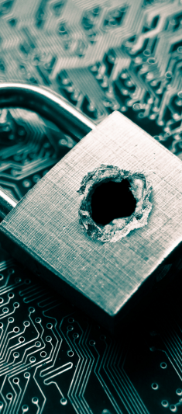
Attacks in the 3rd round
Nov 2020 – Gemss attack
  All parameter sets fall below security level 1
Feb 2022 – Rainbow attack
  “Breaking rainbow takes a weekend on a laptop” (for category 1)
Apr 2022 – attack on structured lattice schemes
  Relevant to Kyber, saber, dilithium, and likely ntru
Apr 2022 – attack on sphincs+
  affects category 5 parameters using sha-256

Slide 22




How will NIST make its decisions?
Using the evaluation criteria:
Security
  Security levels offered
  (confidence in) security proof
  Any attacks
  Classical/quantum complexity
Performance
  Size of parameters
  Speed of KeyGen, Enc/Dec, Sign/Verify
  Software and hardware benchmarks
Algorithm and implementation characteristics
  IP issues
  Decryption failures
  Side channel resistance
  Simplicity and clarity of documentation
  Flexible
Other
  Official comments/pqc-forum discussion
  Papers published/presented
1st round
2nd round
3rd round

Slide 23
How will NIST make its decisions?
For the lattice KEMs, the main decision will be Kyber/NTRU/Saber
Similarly for lattice signatures, the main decision will be Dilithium/Falcon
Any other algorithms selected will be their own distinct decision
  Other Finalists: Classic McEliece and Rainbow
  KEM alternates: Bike, HQC, FrodoKEM, NTRUprime, SIKE
  Signature alternates: GeMSS, Picnic, Sphincs+

Slide 24
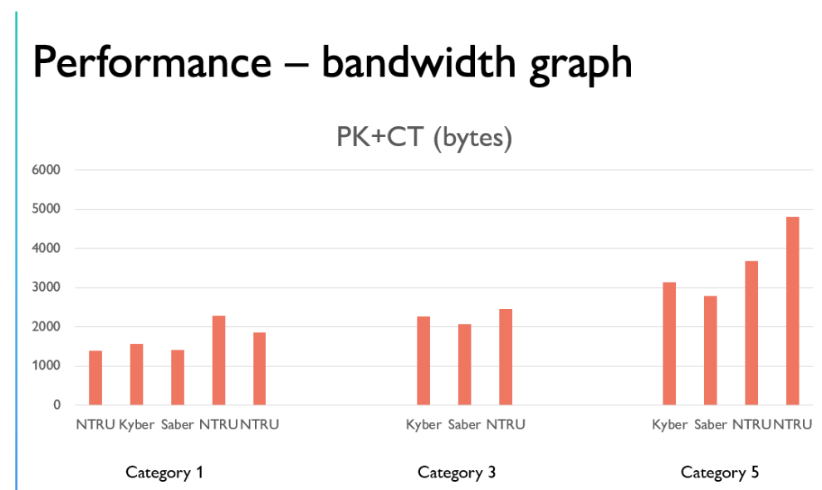
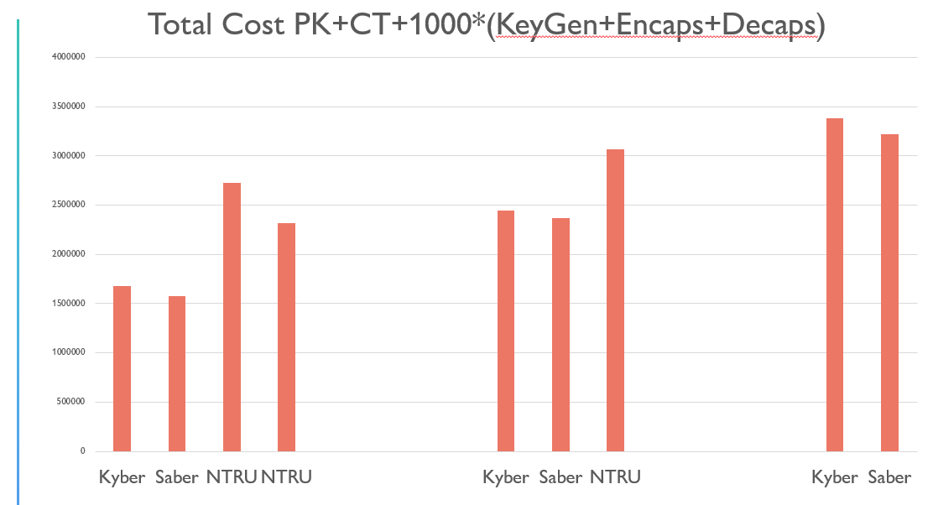
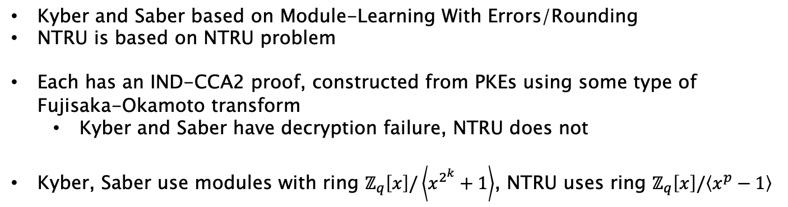
Kyber vs NTRU vs Saber
Kyber and Saber based on Module-Learning With Errors/Rounding
NTRU is based on NTRU problem
Each has an IND-CCA2 proof, constructed from PKEs using some type of Fujisaka-Okamoto transform
  Kyber and Saber have decryption failure, NTRU does not
Kyber, Saber use modules with ring $ℤ_{q}\left[x\right]/\left\langle x^{2^{k}}+1\right\rangle$, NTRU uses ring $ℤ_{q}\left[x\right]/\left\langle x^{p}−1\right\rangle$
Total Cost: 1000*(PK+CT)+KeyGen+Encaps+Decaps
Software – AVX2 processor

Slide 25
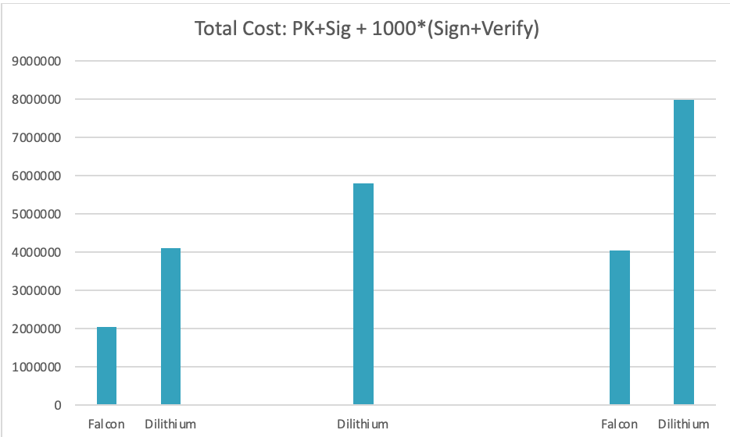
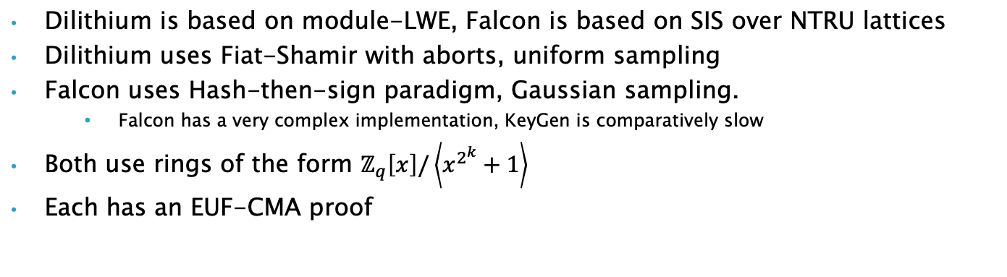
Dilithium vs Falcon
Dilithium is based on module-LWE, Falcon is based on SIS over NTRU lattices
Dilithium uses Fiat-Shamir with aborts, uniform sampling
Falcon uses Hash-then-sign paradigm, Gaussian sampling.
  Falcon has a very complex implementation, KeyGen is comparatively slow
Both use rings of the form $ℤ_{q}\left[x\right]/\left\langle x^{2^{k}}+1\right\rangle$
Each has an EUF-CMA proof
Total Cost: 1000*(PK+Sig)+Sign+Verify
Software – AVX2 processor
Notes:
Dilithium – pretty straightforward? (uniform sampling everywhere)​
Falcon keygen and FFT-samp are delicate to implement​, Floating-pt arithmetic​
53 bits of precision – no problem in software. A concern in resource-constrained hardware without native support

Slide 26
Patent and IPR issues
“NIST does not object in principle to algorithms or implementations which may require the use of a patent claim, where technical reasons justify this approach, but will consider any factors which could hinder adoption in the evaluation process.”
This is a very complicated area
We acknowledge the impact of encumbered technology on adoption
NIST is actively engaging to try to resolve known IPR issues on the candidates
When we have something concrete, we will share it
Note: it may not be possible for NIST to resolve all IP concerns
Notes:
NIST will consider the IPR impact when making selections. Actually, even though we did not receive a lot feedback, it is clear that the candidates with IPR issues would not be adopted.
We agree critical for adoption
Really emphasize not enough public feedback on impact of IP
As was described in the original Call for Algorithms, and discussed on the PQC Forum, NIST has been reviewing intellectual property claims against the PQC finalists.
While submitters were required to disclose applicable patents and declare their intent for regarding licensing, a challenge in this process has been addressing IP claims by third parties, particularly against lattice-based candidates.
NIST has been engaging IP holders to discuss applicability and intentions regarding licensing, including preliminary discussions with CNRS.
While it is not clear whether these patents apply to the PQC finalists, we recognize the impact that even questions over IPR and licensing terms can have on the adoption of cryptographic algorithms.
While we intend to word towards clarity on these issues, we note that there are no easy answers or solutions to these questions, and we want to acknowledge NIST’s constraints up-front to avoid potential misunderstandings.
We do not expect definitive answers on the applicability of patent during the timeline of this selection process.
Furthermore, NIST does not have significant resources to license patents on behalf of implementers and users of cryptographic technologies.
Ultimately, we want to hear from the community how intellectual property considerations will impact their adoption of any of the finalists, including questions over applicability and the effect of royalty-bearing licenses.
We welcome discussion of these issues, on the PQC Forum and other venues, as input to the selection and standardization process.

Slide 27

Timeline
The 3rd Round will end any day now!
  NIST will announce which finalist algorithms it will standardize
    Including potentially the alternate SPHINCS+
  This will include algorithms which will be able to be used by most applications
  NIST will issue a Report on the 3rd Round to explain our decisions
NIST will also announce any candidates advancing to 4th round
  The 4th round will similarly be 18-24 months
  These algorithms will be for a diversified portfolio
We’ll likely hold a workshop in fall/winter 2022
We plan to release draft standards for public comment in 2022-2023
The first set of standards should be finalized by 2024

Slide 28
Standardization
NIST’s public-key crypto is standardized in:
  FIPS 186-5, digital signatures
  SP 800-56A, 800-56B, encryption/key-establishment
NIST will create new standards, in consultation with the candidate teams
  NIST will determine which specific parameter sets to include, and give their security strength
  NIST will seek feedback from community, if needed
The draft standards will be put out for public comment
  Feedback received will be made public
  NIST will make any necessary revisions and then publish the Standard
Notes:
New documents will similarly be in SP’s or FIPS
A standard specifies the scheme’s details, including recommended parameter sets and primitive choices to instantiate it.
Pretty much all the details you’d need to know to implement it
Also give some guidance for its safe usage
No major changes should be expected, but some possible small tweaking
Category 1 parameters, maybe? Or be more conservative and start with category 3 parameters

Slide 29

An on-ramp for signatures
After the conclusion of the 3rd Round, NIST will issue a new Call for Signatures
  There will be a deadline for submission, likely Jan 2023
  This will be much smaller in scope than main NIST PQC effort
  The main reason for this call is to diversify our signature portfolio
  These signatures will be on a different track than the candidates in the 4th round
We are most interested in a general-purpose digital signature scheme which is not based on structured lattices
  We may be interested in other signature schemes targeted for certain applications. For example, a scheme with very short signatures.
The more mature the scheme, the better.
NIST will decide which (if any) of the received schemes to focus attention on

Slide 30
Research Challenges
Many important topics studied:
  Security proofs in both the ROM and QROM
  Does the specific ring/module/field choice matter for security?
    Or choice of noise distribution?
    Does “product” or “quotient” style LWE matter?
  Finer-grained metrics for security of lattice-based crypto (coreSVP vs. real-world security)
    More generally, what cost models should we be using to measure attacks?
  Are there any important attack avenues that have gone unnoticed?
  Side-channel attacks/resistant implementations
  More hardware implementations
  Ease of implementations – decryption failures, floating point arithmetic, noise sampling, etc.
  Algebraic cryptanalysis of cyclotomics for lattices

Slide 31
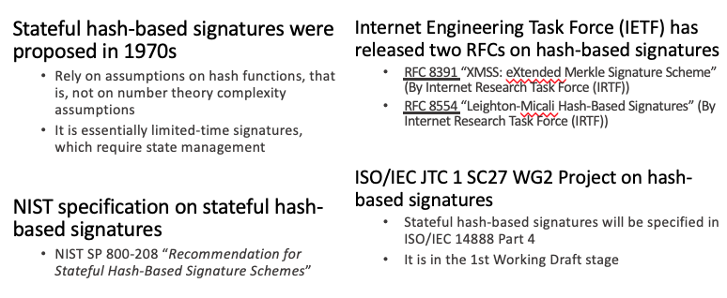
Stateful Hash Based Signatures for Early Adoption

Slide 32

Hybrid mode – An approach for migration
NIST SP800-56C Rev. 2 Recommendation for Key-Derivation Methods in Key-Establishment Schemes August 2020
  “In addition to the currently approved techniques for the generation of the shared secret Z … this Recommendation permits the use of a “hybrid” shared secret of the form Z′ = Z || T, a concatenation consisting of a “standard” shared secret Z that was generated during the execution of a key-establishment scheme (as currently specified in [SP 800-56A] or [SP 800-56B]) followed by an auxiliary shared secret T that has been generated using some other method”
A
B
ECDH
PQC
ECDH
PQC
ECDH
Z
KDF($Z||T$)
The above is just an illustration. The actual combination of two schemes will depend on the protocol specifications.
Notes:
If do this – better slide
This is for protocol designers and implementers choosing to implement a hybrid scheme
The figure may demonstrate “non-composite” bybrid mode. It is not my intention to limit it to non-composite. But you may say something that this is just an illustration. The actual combination of two schemes depends on the protocol specifications.eme.

Slide 33
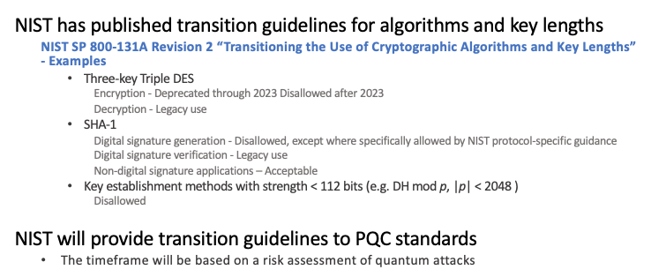
Crypto transitions

Slide 34
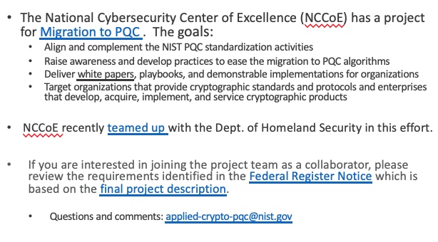


Getting ready for PQC
Notes:
The National Institute of Standards and Technology (NIST) National Cybersecurity Center of Excellence (NCCoE) is inviting industry participants and other interested parties to participate in the Migration to Post-Quantum Cryptography project.
If you are interested in joining the project team as a collaborator, please review the requirements identified in the Federal Register Notice which is based on the final project description.
Next, complete this short form and we will send you a Letter of Interest template along with instructions.
Completed submissions are considered on a first-come, first served basis.
Questions and comments on this publication may also be submitted to applied-crypto-pqc@nist.gov.

Slide 35
Other Standards Organizations
We are aware that many standards organizations and expert groups are working on PQC
  IEEE P1363.3 has standardized some lattice-based schemes
  IETF has standardized stateful hash-based signatures LMS/XMSS
  ETSI has released quantum-safe cryptography reports
  EU expert groups PQCRYPTO and SAFEcrypto made recommendations and released reports
  ISO/IEC JTC 1 SC27 had a study period for quantum-resistant cryptography and released a standing document (SD)
NIST is interacting and collaborating with these organizations and groups
Some countries have begun standardization activities
Notes:
Mention other countries
Not say much here

Slide 36

Conclusion
The Beginning of the End is here!
NIST is grateful for everybody’s efforts
Check out www.nist.gov/pqcrypto
  Sign up for the pqc-forum for announcements & discussion
  send e-mail to pqc-comments@nist.gov
Notes:
Talk about some attacks on lattices and sphincs+

Slide 37
What can organizations do now?
Perform a quantum risk assessment within your organization
  Identify information assets and their current crypto protection
  Identify what ‘x’, ‘y’, and ‘z’ might be for you – determine your quantum risk
  Prioritize activities required to maintain awareness, and to migrate technology to quantum-safe solutions
Evaluate vendor products with quantum safe features
  Know which products are not quantum safe
  Ask vendors for quantum safe features in procurement templates
Develop an internal knowledge base amongst IT staff
Track developments in quantum computing and quantum safe solutions, and to establish a roadmap to quantum readiness for your organization
Act now – it will be less expensive, less disruptive, and less likely to have mistakes caused by rushing and scrambling

